Slide 1
Data Divers
AI-Driven Music Recommendation Application
RecNN
Andrew Mark Dale
Abednego njani Ndegwa
Ashutosh Pandey
Darren Saguil
Nikhil Lohar

Slide 2
What we’ve accomplished thus far
Model has been completed and is recommending songs
Front-end has many of the features we discussed in the Kick-Off meeting
Top 10 popular song cards, using the popularity metric in the dataset, click them!
Search bar list populates from our dataset. User can select a song. And it populates a recommendation list.
Website has both a light and dark mode.
Work still to do:
Polish website.
Cut down on time loading assets (dataset is rather large).
Move website and model to the cloud instead of being hosted locally. To allow for free use. This had already begun as we’ve started to move our web application to a cloud service.
Implement Spotify API to generate playlists for the user. (This will also allow use to grab artist images etc.)

Slide 3
Back-end (Model, Python)
Model is an unsupervised kNN as was the plan in the kick-off meeting.
Built using libraries and modules in Python (scikit-learn, pandas, numpy)
Currently, model is being hosted locally using Flask.
Pass a unique track identifier to the model, it returns k number of neighbours
k is currently fixed at 10, the user will be able to choose the number of songs they desire once implemented.
Considering adding another model that will allow the user to get recommendations if they select a genre. As well as possibly others to provide a better user experience.

Slide 4
Front-end (Website Application)
Built using React, next.js, Chakra UI.
Can be hosted locally or you can try the demo link!
You need to run the back-end locally for now if you wish to use the demo. We have included instructions in the Readme.
The website currently has the search bar which allows a user to select their desired song. This populates a recommended song list.
The website has both a light and dark mode which is toggleable.
Try using either the search function or the popular song cards!

Slide 5
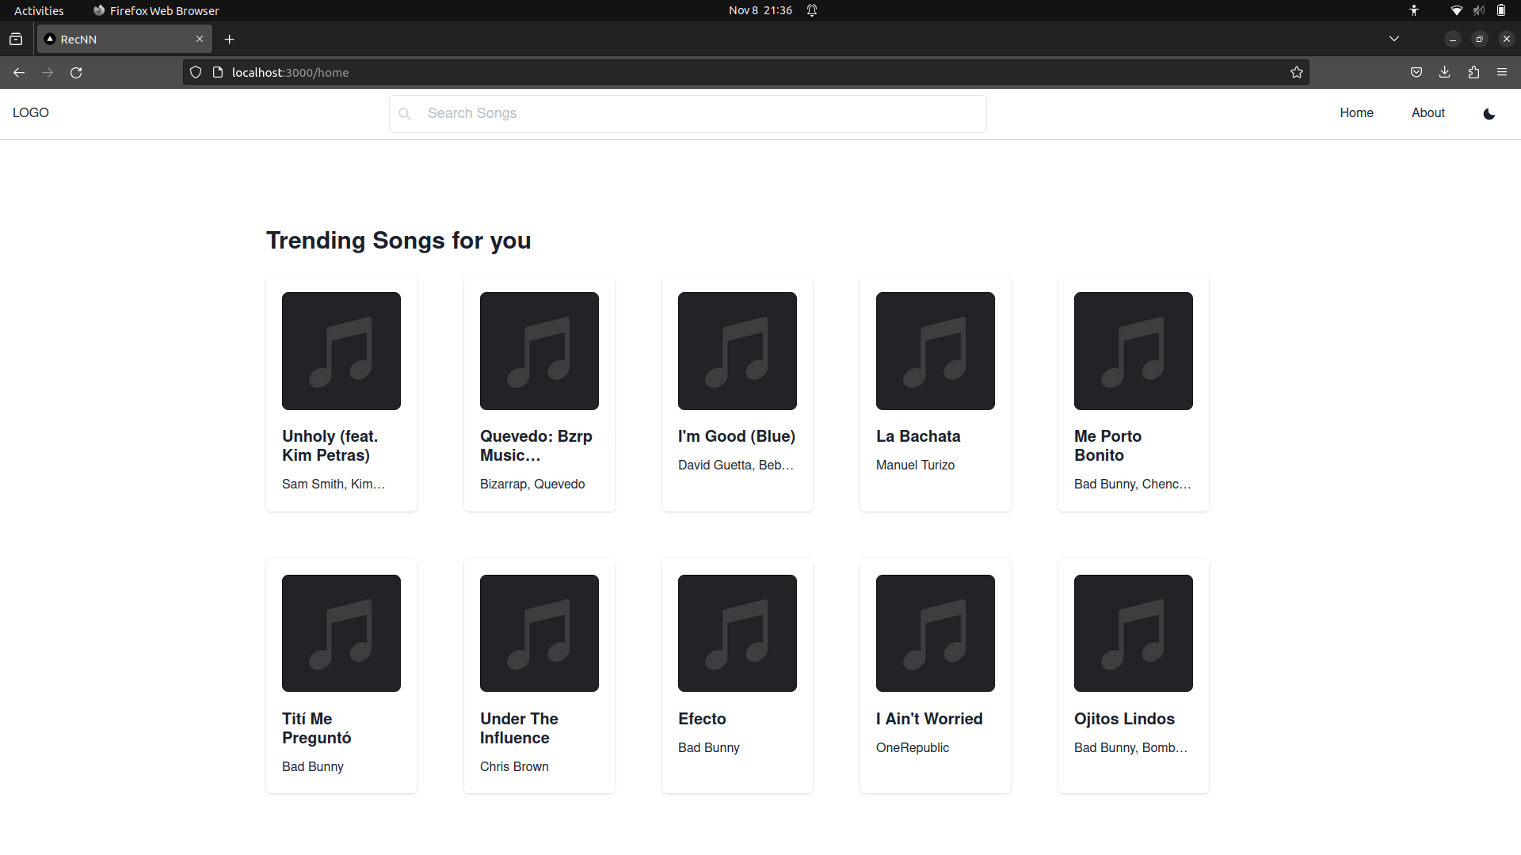
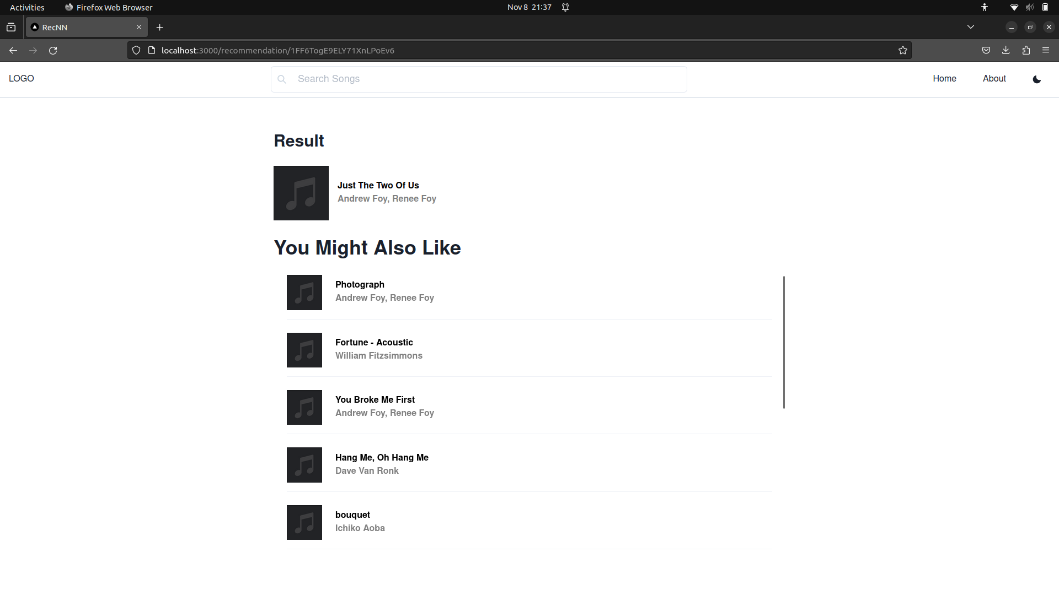
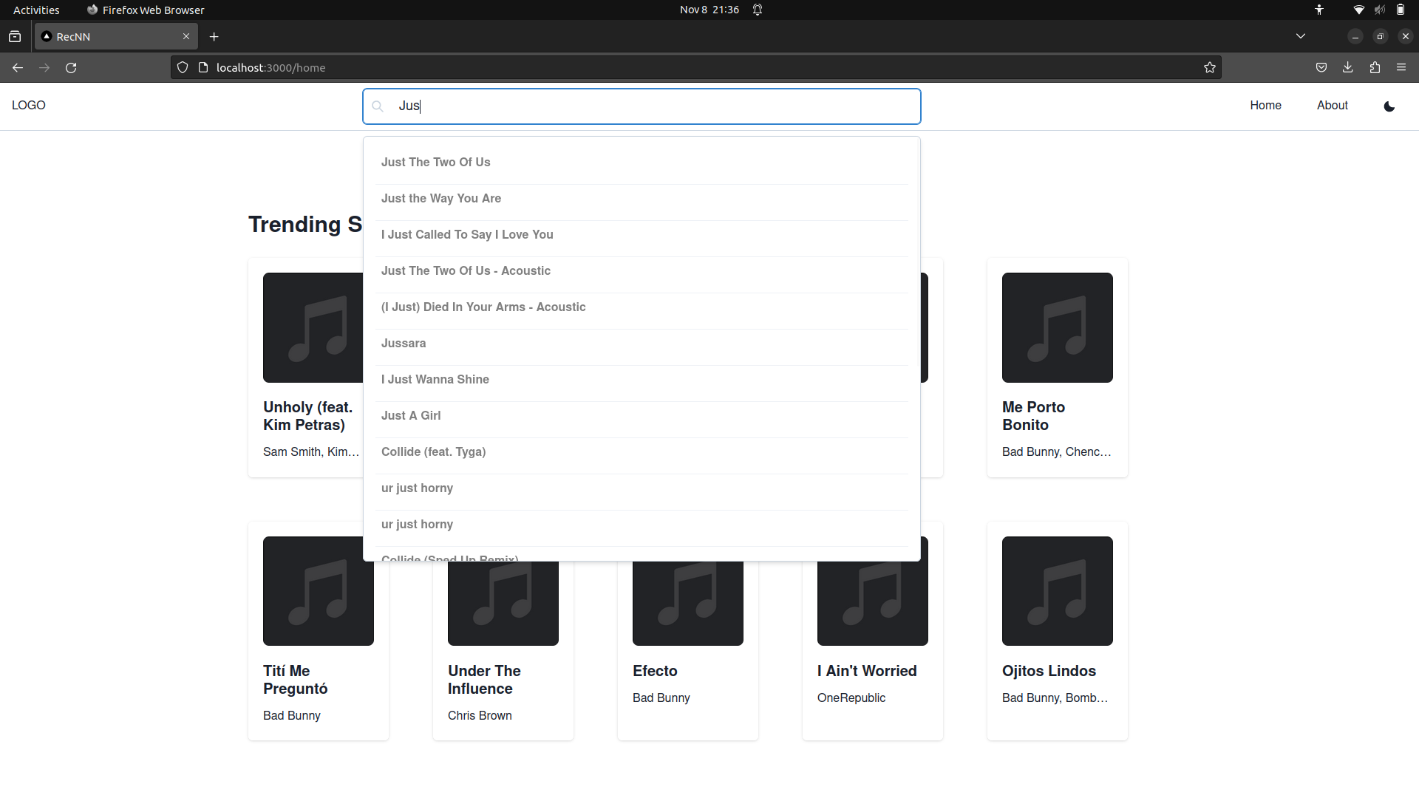
Demo of our functional prototype

